Slide 1
Fundamentals 0f Operating System

Slide 2
Necessity of OS
OS is an interface between user and hardware
Is OS really required ?
USER
OS
COMPUTER HARDWARE

Slide 3
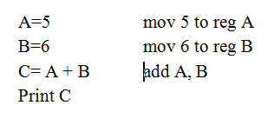
Example 1
Is it possible to run this program without OS ?

Slide 4
To execute this program MM, CPU is required which is available.
OS is not required for the execution of any program because ultimately the program consist of machine level instructions.
Hence there is no role of OS.
Why OS is used ?

Slide 5
Device driver is required to interact with I/O device.
It is an I/O program to control the activity of an I/O device.
Check printer is on
Is it able to print data
Send data to the buffer
Then data is printed
OS
DEVICE DRIVER
INPUT/OUTPUT DEVICE

Slide 6
Problem
I/O device understand the language of signals
CPU can understand your instructions but I/O can not

Slide 7
Device controller is used
DC Generates signal (to move head on tracks and sectors
Initialize the head
Accept the character
Print character
OS
DEVICE DRIVER
DEVICE CONTROLLER
I/O DEVICE

Slide 8
Example 2
If user wants to write a program p1.c and require to store this program on hard disk
The user need to do following :
Check space is available or not
Where is it available –track no., sector no.
Store the data on track no., sector no.
Now suppose user want to retrieve the data, but how ?

Slide 9
Problem
User have to remember the track no., sector no.
If another user write p2.c program where p1.c is stored then the program is overwritten
So for the management of resource OS is required

Slide 10
Purpose of OS
Primary purpose is to provide user convenience
Secondary purpose is to manage all the resources of the computer system

Slide 11
OS Services
Q As a user what services you want from OS?
OS should do all these for a user
Resource Management
Provide GUI
Provide Security
Support different versions of H/W
Support Multitasking etc.

Slide 12
Why is Booting Required ?
Hardware doesn’t know where the operating system resides and how to load it.
Need a special program to do this job – Bootstrap loader.
  E.g. BIOS – Boot Input Output System.
Bootstrap loader locates the kernel, loads it into main memory and starts its execution.

Slide 13
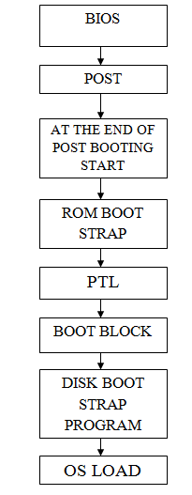

Slide 14
Secondary Boot Loaders
If there is no active partition or the active partition's boot sector is invalid, the MBR may load a secondary boot loader and pass control to it and this secondary boot loader will select a partition (often via user input) and load its boot sector.
Examples of secondary boot loaders
  GRUB – GRand Unified Bootloader
  LILO – LInux LOader
  NTLDR – NT Loader

Slide 15
GRUB: GRand Unified Bootloader
GRUB is an operating system independent boot loader
A multiboot software packet from GNU
Flexible command line interface
File system access
Support multiple executable format
Support diskless system
Download OS from network

Slide 16
GRUB boot process
The BIOS finds a bootable device (hard disk) and transfers control to the master boot record
The MBR contains GRUB stage 1. Given the small size of the MBR, Stage 1 immediately loads the next stage of GRUB
GRUB Stage 1.5 is located in the first 30 kilobytes of hard disk immediately following the MBR. Stage 1.5 loads Stage 2.
GRUB Stage 2 receives control, and displays to the user the GRUB boot menu (where the user can manually specify the boot parameters).
GRUB loads the user-selected (or default) kernel into memory and passes control on to the kernel.

Slide 17
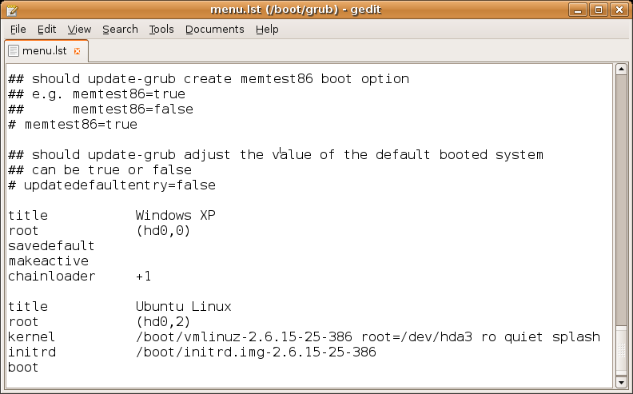
Example GRUB config file

Slide 18
Kernel
The kernel is the central part in most computer operating systems because of its task, which is the management of the system's resources and the communication between hardware and software components
Kernel is always store on memory until computer is turn off

Slide 19
Init process
The first thing the kernel does is to execute init program
Init is the root/parent of all processes executing on Linux
The first processes that init starts is a script /etc/rc.d/rc.sysinit
The init process is identified by process id "1“
Init is responsible for starting system processes as defined in the /etc/inittab file
Init typically will start multiple instances of "getty" which waits for console logins which spawn one's user shell process
Upon shutdown, init controls the sequence and processes for shutdown

Slide 20
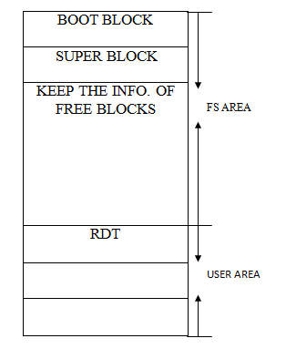
Unix file system
This is the structure of Unix file system which is divided in to two parts –
File system area
User area
Inode table

Slide 21
Boot block –
Very first block created on Unix file system
Standard size = 512 byte
Super block –
Containing the info. About first 50 free blocks
Standard size = 512 byte
Inode table –
Inode size for Unix= 64 B, for Linux 128 B
Inode no. 1 containing the info. of bad blocks
Inode no. 2 containing the info. of RDT
Root Directory Table –
It contains the file name and Inode no.

Slide 22
THANK YOU

